Slide 1
Travel Agency System
Junyao Li, 001050043 Yining Chen, 001586646
Hung-Chih Huang, 001005756

Slide 2
Business Problem
A management system designed for travel agencies so they can automate the booking and traveling for the Customers. Agents can create and manage flight schedule, car booking, hotel booking. With better GUI, this will provide ease of management

Slide 3
Target Audience
Travel Agents
Customers

Slide 4
Customer Directory
Customer Directory stores multiple informations of customer, includings personal informations, flight tickets.
Customer have one to many relationship with car, hotel, and flight booking Id
Travel agencies can add new Customer to directory and obtain the Customer Directory

Slide 5
Ticket
Ticket has the Customer’s name, fight and seat entitis.

Slide 6
Airliner Directory
Airliner Directory is the array of Airliner

Slide 7
Flight Schedule Multiple Stop
Flight Schedule Multiple Stop has array of FlightSchedule with details of Flight, Stop, destination, Stop
More than one FlighSchedule in the array meanings that it’s multiple stop.Vice versa meaning that it’s only one stop.
Each FlightSchedule has one Flight Entity. If the Flight Entity has no Customer meaning that not being occupied

Slide 8
Car Directory
Car Directory is array of car with all the details of Cars such as Serial Number, Model Number, Renting price, Destination, Source, and Customer.
Car directory has one to one relationship with Customer and many to one relationship with travel agencies. Travel Agency can search for Car informations through car bookingID.
If the Car informations have no Customer, meaning that the car is not being occupied.

Slide 9
Hotel Directory
Hotel Directory is array of hotel with all the details of Hotel such as Hotel name, Location, Room Number, facilities.
Hotel directory has one to one relationship with Customer and many to one relationship with travel agencies. Travel Agency can search for Hotel informations through hotel bookingID.
Hotel informations show the room being occupied or not.

Slide 10
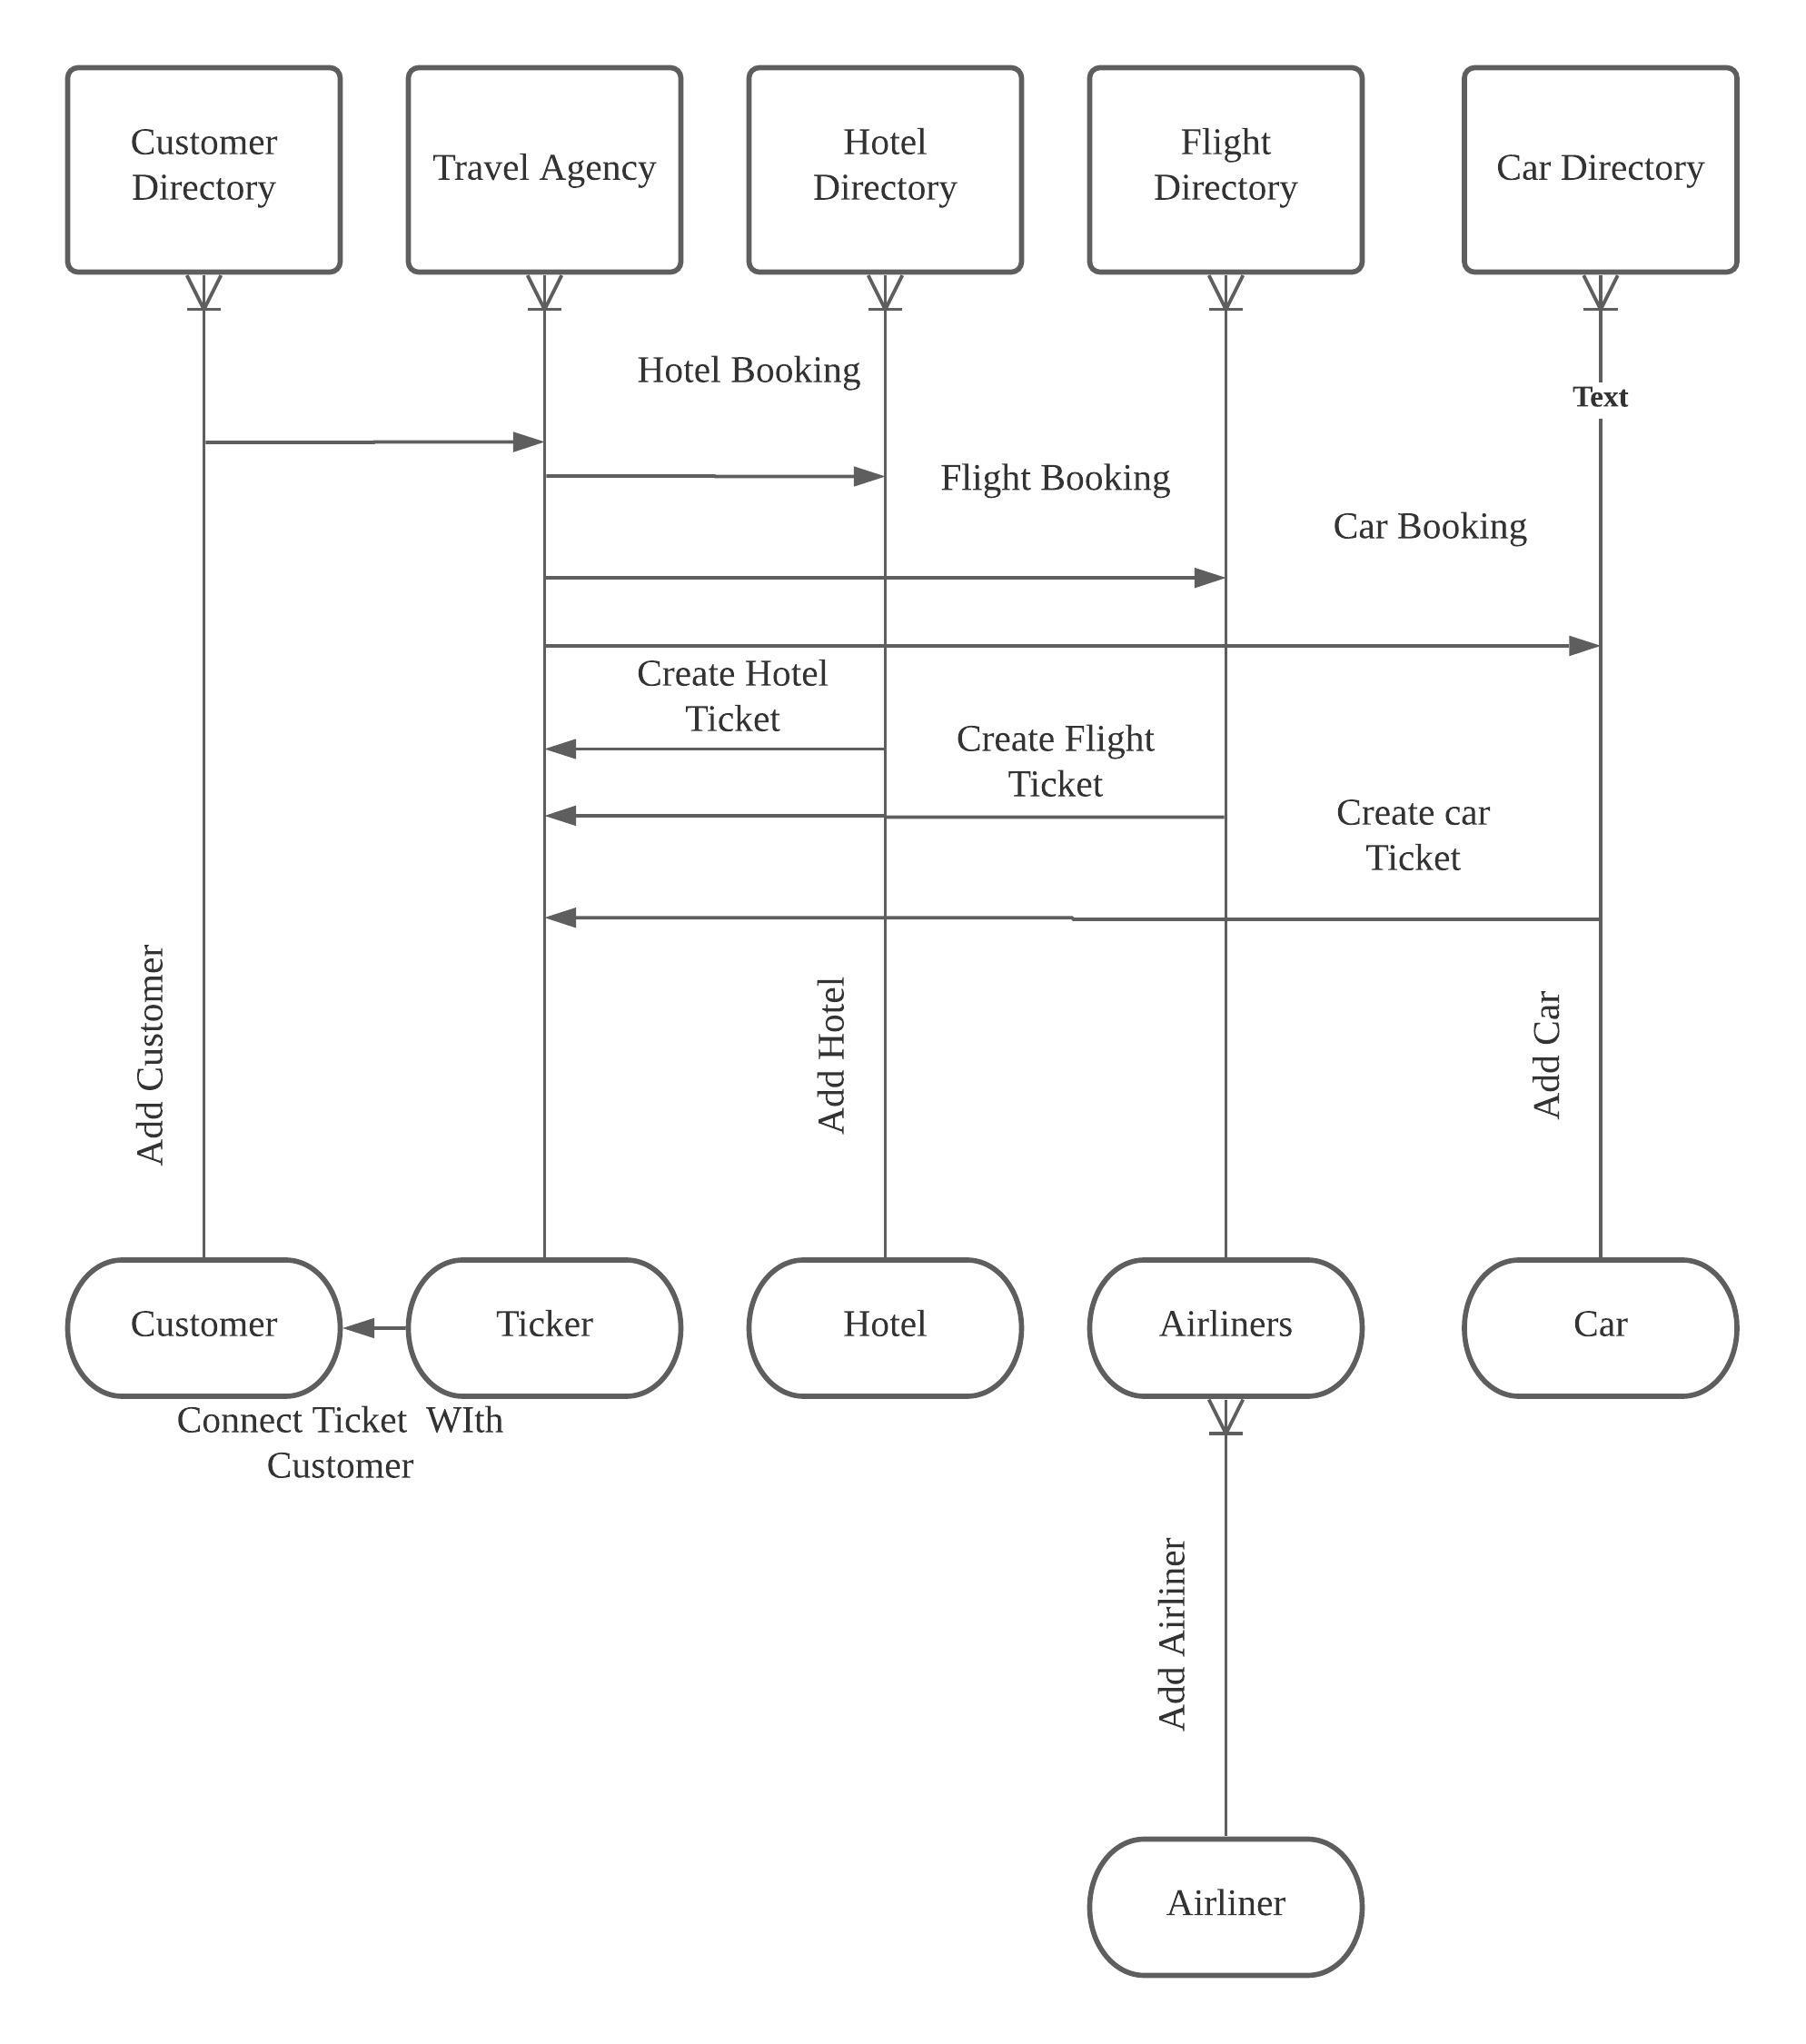
Sequence Diagram

Slide 11
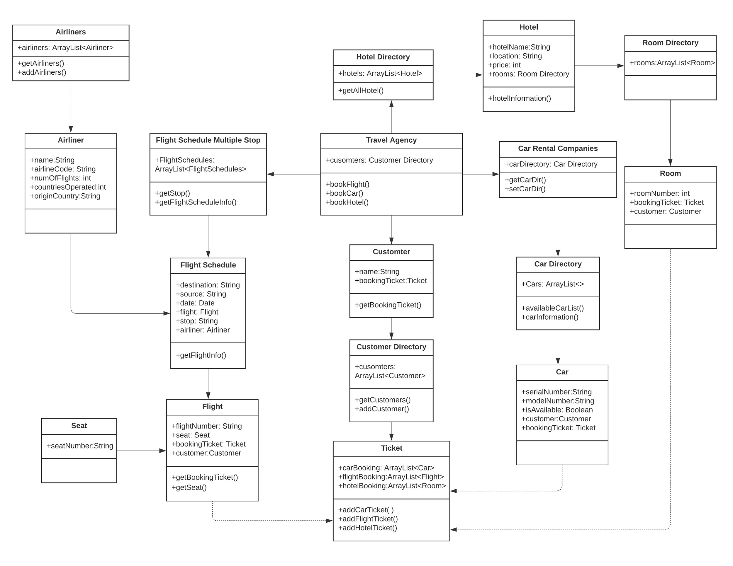
Model Diagram

